Slide 2
Syntax and Semantics

Slide 3
Languages in General
All languages have a set of symbols, rules for constructing compound constructions out of atomic constructions and meaning assigned to the significant units.
E.g., the letter ‘A’ is part of English, but not part of Hindi.
E.g., English is a Subject-Verb-Object language, where Arabic is Subject-Object-Verb language.
E.g., ‘snow’ means snow in English, but ‘schnee’ means snow in German.
Syntax :The form or structure of the expressions, statements, and program units. It is the grammar of the language.
Semantics: The meaning of significant parts(expressions, statements, and program units.

Slide 4
Comparison Chart
BASIS FOR COMPARISON | SYNTAX | SEMANTICS
Basic | Permitted phrases of a language. | Interpretation of the phrases.
Errors | Handled at the compile time. | Confronted at runtime.
Relation | Syntactic interpretation must have some distinctive meaning. | Semantic component is associated with a syntactic representation.
Notes:
Syntax:
It refers to the rules and regulations for writing any statement in a programming language like C/C++.
It does not have to do anything with the meaning of the statement.
A statement is syntactically valid if it follows all the rules.
It is related to the grammar and structure of the language.
Semantics:
It refers to the meaning associated with the statement in a programming language.
It is all about the meaning of the statement which interprets the program easily.
Errors are handled at runtime.

Slide 5
Syntax
The Syntax of a programming language is used to signify the structure of programs without considering their meaning.
It basically emphasizes the structure, layout of a program with their appearance.
It involves a collection of rules which validates the sequence of symbols and instruction used in a program.
The pragmatic and computation model figures these syntactic components of a programming language.
The tools evolved for the specification of the syntax of the programming languages are regular, context-free and attribute grammars (AUTOMATA THEORY)

Slide 6
Syntax (Grammar)
The Grammars generally are the rewriting rules whose purpose is to recognize and generate the programs.
Grammar does not rely on the computation model instead used in the description of the structure of the language.
The grammar contains a finite set of grammatical categories (such as noun phrase, verb phrase, article, noun, etc), solitary words (elements of the alphabets) and the well-formed rules to specify the order within which components of the grammatical categories should appear.

Slide 7
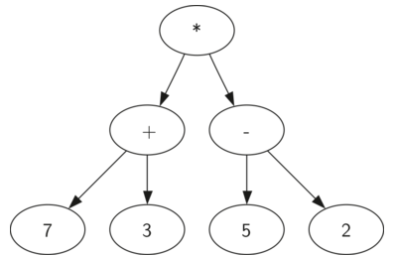
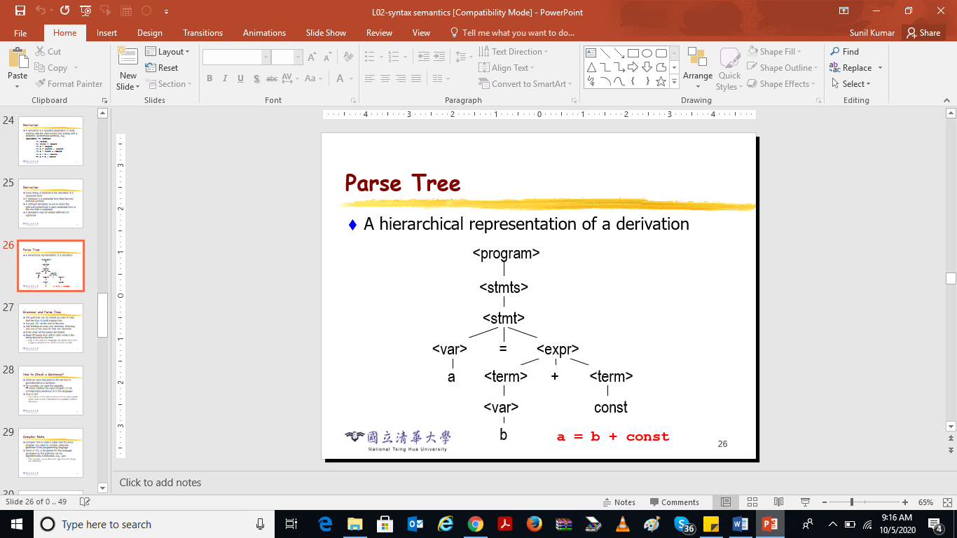
Derivation Tree --- (7+3)* (5-2)
b
a = b + const
Notes:
Derivation Tree
Derivation tree is a graphical representation for the derivation of the given production rules for a given CFG. It is the simple way to show how the derivation can be done to obtain some string from a given set of production rules. The derivation tree is also called a parse tree.
Parse tree follows the precedence of operators. The deepest sub-tree traversed first. So, the operator in the parent node has less precedence over the operator in the sub-tree.
A parse tree contains the following properties:
The root node is always a node indicating start symbols.
The derivation is read from left to right.
The leaf node is always terminal nodes.
The interior nodes are always the non-terminal nodes

Slide 8
Syntax Analysis
Syntax analysis is a task performed by a compiler which examines whether the program has a proper associated derivation tree or not.
The syntax of a programming language can be interpreted using the following formal and informal techniques:
Lexical syntax for defining the rules for basic symbols involving identifiers, literals, punctuators and operators.
Concrete syntax specifies the real representation of the programs with the help of lexical symbols like its alphabet.
Abstract syntax conveys only the vital program information

Slide 9
Types of grammars
Context-free grammar is prevalently used to figure out the whole language structure.
Regular expressions describe the lexical units (tokens) of a programming language.
Attribute grammars specify the context-sensitive part of the language.

Slide 10
Semantics
Semantics term in a programming language is used to figure out the relationship among the syntax and the model of computation.
It emphasizes the interpretation of a program so that the programmer could understand it in an easy way or predict the outcome of program execution.
An approach known as syntax-directed semantics is used to map syntactical constructs to the computational model with the help of a function.
The programming language semantics can be described by the various techniques
Axiomatic semantics
Operational semantics
Denotational semantics
Translation semantics.
Algebraic semantics
Notes:
#include <iostream>
using namespace std;
// Driver Code
int main()
{
// Return statement before cout
return 0;
// Print the value
cout << "GFG!";
}
The output will be blank because the above program is semantically incorrect.
This program has no syntax error as it is following every programming rule but still, it will not print anything on the screen because the return statement is written before the cout statement which causes the program to terminate before printing anything on the screen. This type of situation is considered a semantic error.

Slide 11
Semantics Techniques
Algebraic semantics interprets the program by defining an algebra.
Axiomatic semantics determine the meaning of a program by building assertions about an association that detain at each point in the execution of the program (i.e. implicitly).
Operational semantics compares the languages to the abstract machine, and the program is then evaluated as a sequence of the state transitions.
Denotational semantics expresses the meaning of the program in the form of a set of functions operating on the program state.
Translational semantics focuses on the methods used for translating a program into another language.

